Slide 1
Excel Project
Performance Analysis

Slide 2
Data Explanation
The dataset has:
9 Columns (Date, Item Description, Quantity, Unit Retail, Order Value, Customer Name, Unit COGS, Category, Team Member).
7438 Rows.
Abbreviations: GM: Gross Margin COGS: Cost of Goods Sold
OV: Order Value

Slide 3
Business Questions to answer
What is the total quantity sold for all orders in our data set?
What is the total order value for all orders in our data set?
Which of our Team Members had the highest total order value in 2016?
Total order value increased from 2014 to 2015. But there is an exception: for two items, total order value actually decreased from 2014 to 2015. Which two items are these?

Slide 4
Business Questions to answer
Year-over-year total order value decreased in both 2014-2015 and 2015-2016 for two customers. Which two customers are these?
Over the course of our entire data set (2014-2016), which company placed the individual order with the highest order value?
It’s the end of 2016, and we are considering incentivizing the Team Members by offering each one a $5,000 bonus if the total order value of his or her accounts increased by over 25% from 2015 to 2016. How much will we end up paying the Team Members in bonuses?

Slide 5
Business Questions to answer
Please provide GM% of Cookies

Slide 6
Process
Pivot Table
Sum Function
If statement
GetPivotData
Gross Margin formula
Have been used to answer these business questions.
Here is the dashboard.

Slide 7
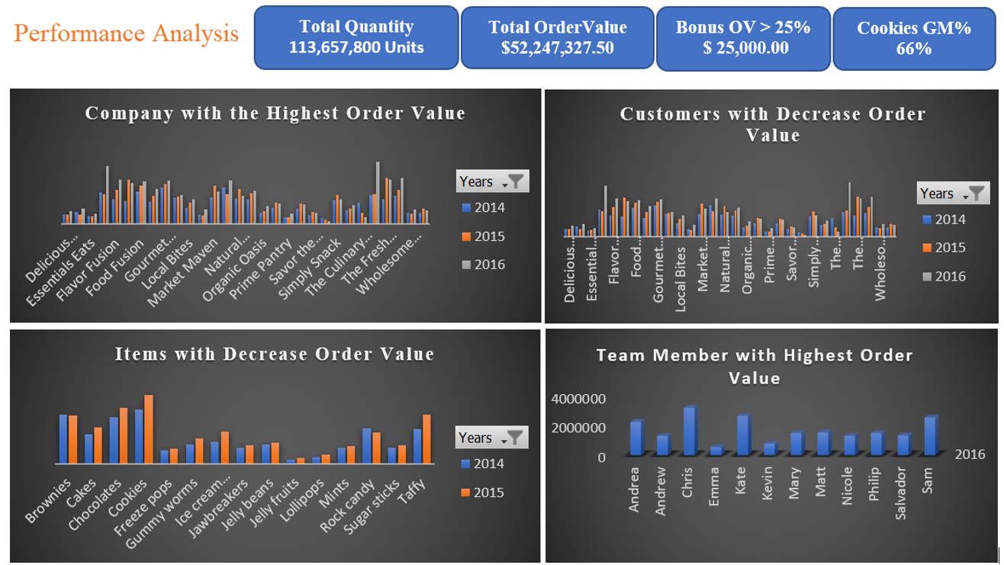

Slide 8
Findings
Overall,
We sold is 113,657,800 Units for a total revenue of $52,247,327.50
The Culinary Coop is the company that has the highest order value and Chris is the team member that has the highest order value in 2016.
Freeze Pops and Ice cream sandwiches are the items that have a decrease order value from 2014 to 2015.

Slide 9
Findings
From 2014 to 2016, Savor the season and The Culinary Coop are the customers that have a decrease order value.
In order to add bonus to the team member that has increased his order value by 25% at the end of 2016, the company will end up paying $25000.
The Gross margin of cookies is 66%.

Slide 10
Thanks to follow along!
Don’t forget to comment and add more insights

